Slide 1


BANK CUSTOMER ANALYSIS REPORT
By Anuraj satardekar
TO ANALYZE CUSTOMER DEMOGRAPHICS, CREDIT PROFILES, AND PRODUCT ENGAGEMENT TO UNCOVER KEY CHURN DRIVERS AND RECOMMEND STRATEGIES FOR IMPROVING RETENTION AND PROFITABILITY.

Slide 2

PROBLEM STATEMENT
You are an analytical CRM (Customer Relationship Management) specialist hired by a bank to extract meaningful insights from various customer-related datasets. The bank aims to reduce customer churn, improve service delivery, and enhance customer satisfaction. They have provided you with datasets including customer demographics, transaction details, customer exit information, and active customer profiles.
Goals:
• DETECT INACTIVE AND ZERO-BALANCE CUSTOMERS
• EVALUATE CHURN PATTERNS BY TENURE, CREDIT SCORE, AND PRODUCT USAGE
• RECOMMEND RETENTION AND CROSS-SELL STRATEGIES TO ENHANCE ENGAGEMENT

Slide 3
DATA OVERVIEW
Dataset : 10,000 Customers | 3 Regions | 7 Key Tables
Sources : bank_churn, customerinfo, geographytype, creditcardtype, activecusttype, exittype
Data Model : Star Schema
• Fact Table : bank_churn
• Dimension Tables : customerinfo, geographytype, creditcardtype, activecusttype, exittype
bank_churn Table (Main Fields)
CustomerId, CreditScore, Tenure, Balance, NumOfProducts, HasCrCard, IsActiveMember, Exited

Slide 4
METHODOLOGY
Data Import & Setup:
• Loaded CSV dataset into Power Query for profiling and transformation
• Imported cleaned data into SQL for analysis
Data Cleaning & Preparation
• Checked for missing values and inconsistencies
• Created derived columns: Exit_Year, Tenure_Group, Credit_Score_Category
SQL Analysis
• Wrote SQL queries to analyze churn, tenure, product usage, and regional trends
• Segmented customers by demographics and engagement level
Dashboard Creation
• Integrated SQL results into Power BI
• Added slicers (Region, Gender, Credit Score, Tenure)
• Designed KPIs and visuals for churn insights and performance tracking

Slide 5
KEY AREAS OF ANALYSIS
1. Credit Score vs Churn
→ Poor credit customers show highest churn (22%); Excellent scorers also churn → service dissatisfaction.
Recommendation : Offer credit improvement programs and premium service tiers for high scorers.
2. Gender & Churn Rate
→ Female churn (25%) > Male (16%) → indicates weaker engagement.
Recommendation : Launch personalized offers and relationship campaigns for female customers.
3. Tenure & Exit Pattern
→ Churn peaks at 4–5 years; longer-tenure customers more loyal.
Recommendation : Introduce loyalty renewal benefits at 3.5 years to retain mid-tenure clients.

Slide 6
KEY AREAS OF ANALYSIS
4. Product Usage & Churn
→ 1-product users = 28% churn; 2-product users = 7% churn (most stable).
Recommendation : Promote cross-sell bundles (Savings → Card → Loan) to move users into the 2-product segment.
5. Regional Performance
→ Germany = highest churn (32%); France & Spain = stable (~16%).
Recommendation : Improve Germany’s service experience and maintain France/Spain engagement models.
6. Credit Card Ownership
→ Similar churn (~20%) for card holders and non-holders — card ownership alone doesn’t drive loyalty.
Recommendation : Add reward-based engagement and cashback programs to credit cards.

Slide 7
OVERALL CUSTOMER OVERVIEW
• 51.5% inactive accounts → low engagement
• 4,000 zero-balance accounts → weak primary usage
• Churn rate = 20.4% (~2,000 customers; ₹185.6M impact)
• Average tenure = 4.8 years
• Deposits ↑ 12–15% YoY | Acquisition ↑ 10–12% YoY
• 50% customers use only 1 service → cross-sell potential
• Majority: Adult & Young Adult age groups
• 1K Fair-score customers without credit cards → upsell opportunity

Slide 8
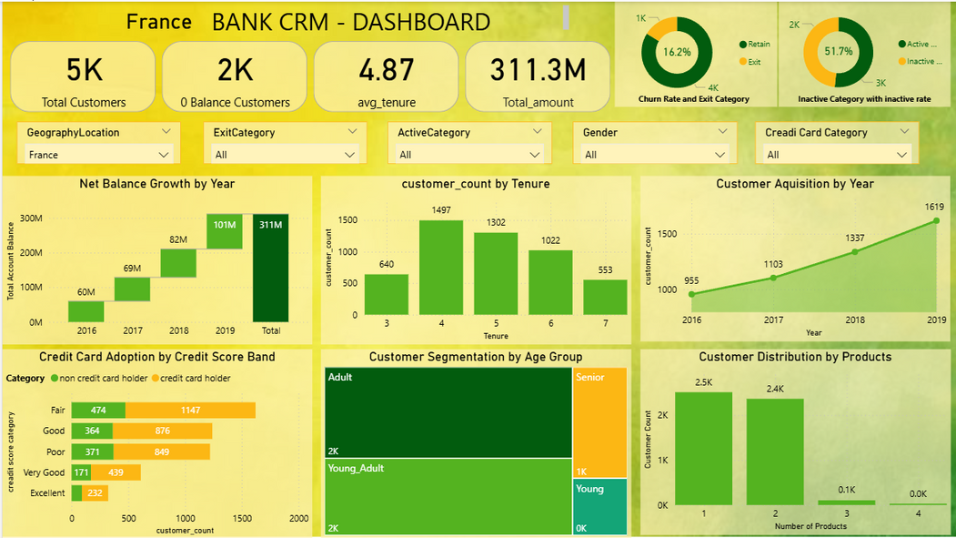
COUNTRY INSIGHTS: FRANCE
• ~50% of total customers; largest deposit base
• Churn: ~16% (below overall rate)
• 90% Adults & Young Adults
• 50% of all 4-service users from France → strong product usage
• 2,000 zero-balance accounts → engagement gap
Recommendation:
Reactivation drives for zero-balance users; replicate France’s strong product penetration model.
WWW.REALLYGREATSITE.COM

Slide 9
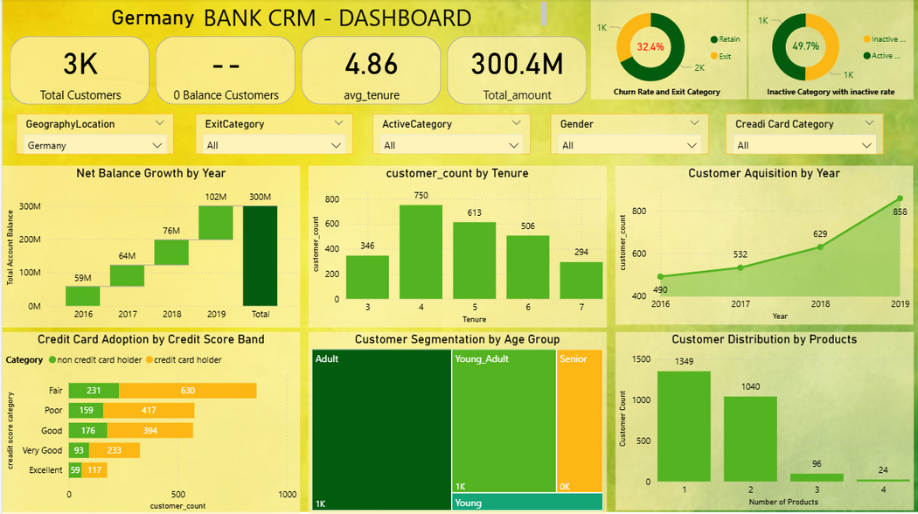
COUNTRY INSIGHTS: GERMANY
• ~30% of total customers
• No zero-balance accounts → active base
• Highest churn: 32.4%
• Poor credit users hold many cards → potential credit risk
• 45% of 4-service users still churn → experience issue
Recommendation:
Improve customer experience, fee transparency, and proactive support for high-value clients.

Slide 10

COUNTRY INSIGHTS: SPAIN
• Smallest customer base
• 50% inactive and many zero-balance accounts
• Churn: ~16.7% (stable but passive)
• Acquisition improving YoY
• Credit card adoption strong
Recommendation:
Focus on activation over acquisition; promote digital onboarding and referral campaigns.

Slide 11
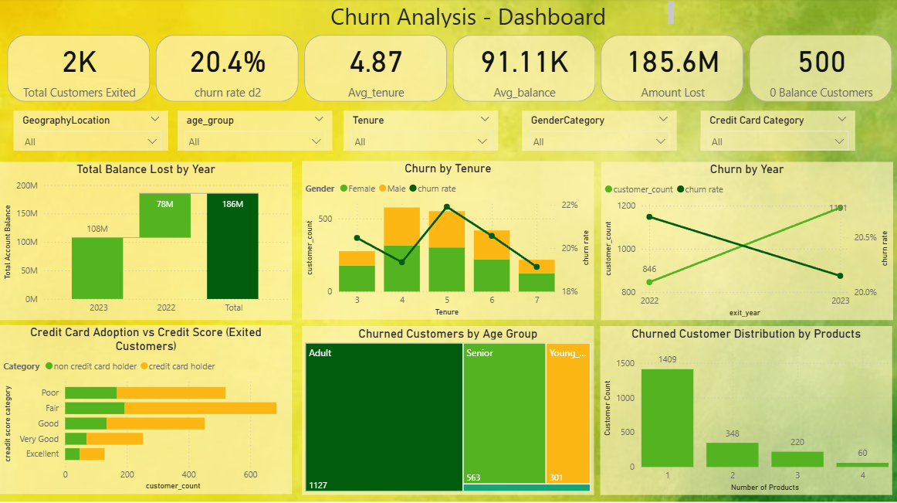
CHURN ANALYSIS

Slide 12
CHURN ANALYSIS
Overall Churn: 20% (improved from 22%)
By Services Used:
• 1 service → 28% churn
• 2 services → 7% churn (most stable)
• 3–4 services → 82–100% churn
By Age Group:
• Young & Young Adult → low churn (7–8%)
• Adults & Seniors → higher churn
By Credit Score:
• Poor → high churn (financial instability)
• Excellent → also churn (service dissatisfaction)
By Tenure:
• Peaks at 4–5 years → key risk window

Slide 13
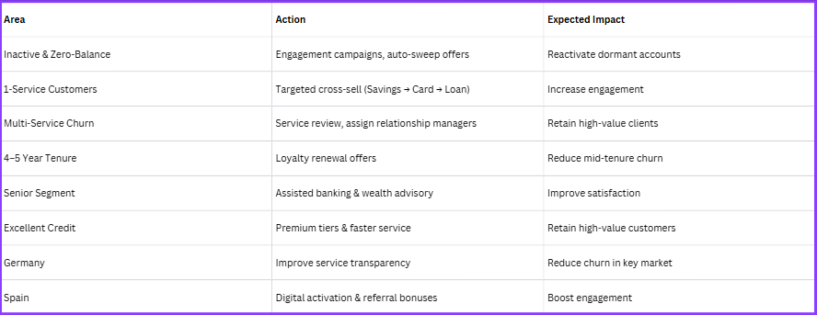
RECOMMENDATIONS

Slide 14
CONCLUSION : Key Takeaways
• Churn improving but inactive accounts remain high
• Germany is the highest-risk region
• Tenure 4–5 years = churn peak
• France = stable market; Spain = improving engagement
• Simplified products and proactive engagement drive retention

Slide 15


thank
you!

